Slide 1

COMP90050
Advanced Database Systems
Winter Semester, 2023
Lecturer: Farhana Choudhury (PhD)
Week 1 part 1

Slide 2




Subject introduction
All successful companies and organizations rely on usage of data
Database: a large, integrated, structured collection of data
These Photos are by Unknown Author is licensed under CC BY

Slide 3
Subject introduction
A Database Management System (DBMS) is a software system designed to store, manage, and facilitate access to databases.
A database system should provide
Ability to retrieve and process the data effectively and efficiently
Secure and reliable storage of data
Database performance metrics

Slide 4

Subject introduction
This is more complex due to:
More data
More aspects of businesses
Stored in various sites and accessed by many users
More complex data types such as images, social network, videos, etc.

Slide 5
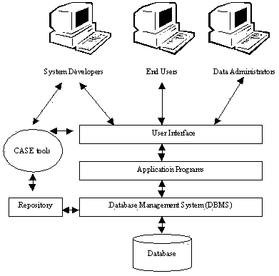
We will cover
  Essentials to achieve correct behaviour and the best possible performance
  Knowledge of how DB systems work
  Mechanisms used by current systems to provide useful features
  Advanced topics

Slide 6
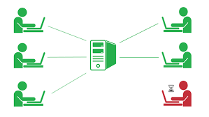

Core Concepts of Database management system
Efficiency
- Disks and I/O bandwidth
- Main memory
- Type of architecture
Database performance metrics
Hardware
Software/ DB tuning
- Types of DB
- Indexing
- Query optimisation
Efficiency/speed
Effectiveness
Effectiveness
Concurrent users
Users reading and writing over the same data
Security & Reliability
Transactions
Required tasks are all done together
Reliability
Crash recovery
Fault tolerance
Data duplication

Slide 7
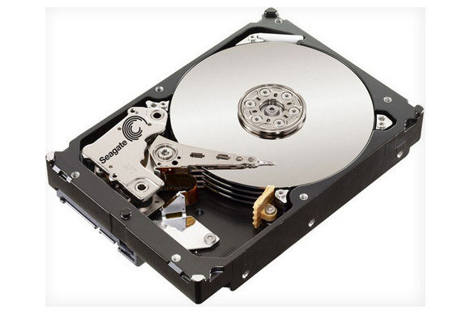
One piece of this became the dominant factor:
Access to stored data in an efficient manner
You will find this picture even on the cover of DB books!

Slide 8
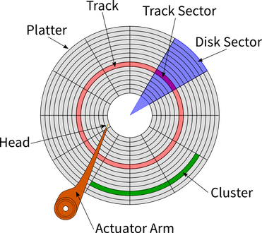
Basic Hardware of a classical disk
Rapidly rotating
- Tracks: circular path on disk surface
- Tracks are subdivided into disk sectors
with magnetic head, which reads
and writes data to the platter surfaces

Slide 9

https://www.youtube.com/watch?v=wteUW2sL7bc

Slide 10
Disk access
# What is the Disk access time for a transfer size of 4KB, when average seek time is 12 ms, rotation delay 4 ms, transfer rate 4MB/sec?

Slide 11
SSD (Solid-State Drive/Solid-State Disk)
No moving parts like Hard Disk Drive (HDD)
Silicon rather than magnetic materials
No seek/rotational latency
No start-up times like HDD
Runs silently
Random access of typically under 100 micro-seconds compared 2000 - 3000 micro-seconds for HDD
Relatively very expensive, thus did not dominate at all fronts yet
Certain read/write limitations plagued it for years
Disk access time =

Slide 12
SSD specification example
Samsung 860 PRO SATA III 2.5-inch
Capacity: 4TB SSD
Price: Many hundreds of dollars
Weight: < 62 grams
Bandwidth Performance (SATA Standard Serial)
  Sustained Sequential Read: up to 560 MB/s
  Sustained Sequential Write: up to 530MB/s
Read and Write IOPS (Input/Output Per Second) – QD32
  Random 4 KB Reads: Up to 100,000 IOPS
  Random 4 KB Writes: Up to 90,000 IOPS

Slide 13
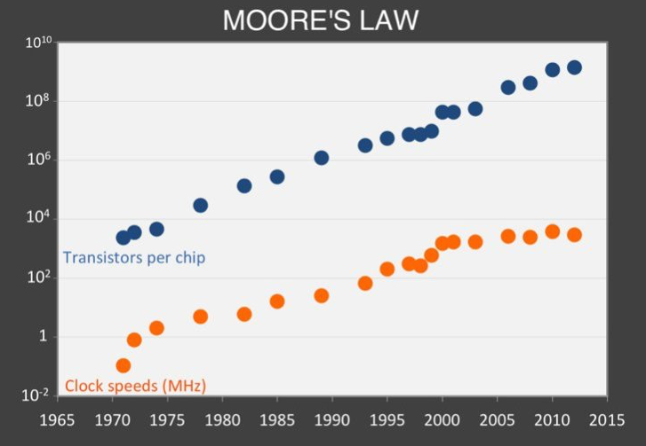
Other Hardware Considerations
Observations on historical trends on chips

Slide 14
Basically: are we going into the age of CPUs?
  Moore’s law: memory chip capacity doubles every 18 months since 1970
  Joy’s law for processors: processor performance doubles every two years since 1984

Slide 15
Hardware spec examples
  How’s recent hardwares are doing…
  Blue Gene/P performs 1 Petaflops (2⁵⁰)/s using ~300,000 CPUs, a decade ago…
  IBM Summit (2019) performs 200 Petaflops (200,000 trillion calculations/second). Summit more than doubles the top speeds of TaihuLight Supercomputer (2018) which was 1 year older
  Very soon we will be measuring the performance by number of cores as individual CPU is reaching its maximum clock speeds
  Intel’s Xeon Cascade Lake series can have up to 48 cores

Slide 16
Some numbers to recall before looking at storage
Metric | Value |  |  | Bytes
Byte (B) | 1 | 2⁰ | 10⁰ | 1
Kilobyte (KB) | 1,024¹ | 2¹⁰ | 10³ | 1,024
Megabyte (MB) | 1,024² | 2²⁰ | 10⁶ | 1,048,576
Gigabyte (GB) | 1,024³ | 2³⁰ | 10⁹ | 1,073,741,824
Terabyte (TB) | 1,024⁴ | 2⁴⁰ | 10¹² | 1,099,511,627,776
Petabyte (PB) | 1,024⁵ | 2⁵⁰ | 10¹⁸ | 1,125,899,906,842,624
Exabyte (EB) | 1,024⁶ | 2⁶⁰ | 10²¹ | 1,152,921,504,606,846,976
Zettabyte (ZB) | 1,024⁷ | 2⁷⁰ | 10²⁴ | 1,180,591,620,717,411,303,424
Yottabyte (YB) | 1,024⁸ | 2⁸⁰ | 10²⁷ | 1,208,925,819,614,629,174,706,176

Slide 17
So where do we store data:
The Memory Hierarchy
Basic structure
Processor
Regs
On chip
L1 Cache
There is usually
10-100 times
drop in
access
speed from on
Chip to off
chip
L2 Cache
Off chip
Main Memory
Harddisk

Slide 18
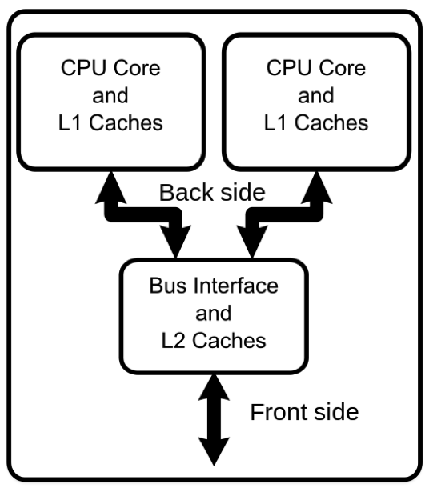
Multi-Core System

Slide 19
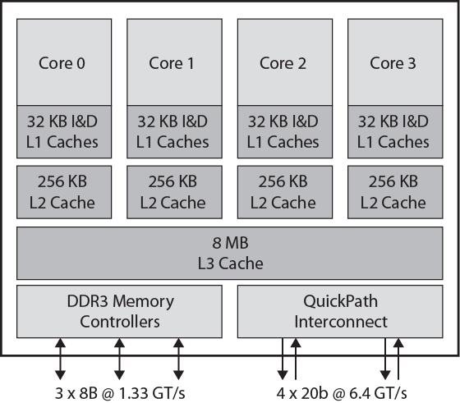
Intel Core i7 Block Diagram
Increasingly L1, L2 and L3 caches are on the chip now!
Slower and
Larger

Slide 20
Memory hierarchy
Effective memory access time,
EA = H*C+(1-H)*M
where H = hit ratio,
C = cache access time;
M = memory access time
Processor
Regs
H times from
Cache
Caches
On chip
Remaining
(1-H) times
from memory
Main Memory
Off chip
Hit ratio | Effective access time as multiple of C, M = 100 C
50.00% | 50.5
90.00% | 10.9
99.90% | 1.1

Slide 21
Memory hierarchy
If data needs to be transferred from HDD
Caching provided with HDD for access
Effective disk buffer access time,
EA = HB*BC+(1-HB)*D where
HB = hit ratio of the disk buffer , BC = buffer access time; D = disk access time
Hit ratio | Effective access time as multiple of BC, D = 1000 C
50.00% | 500.5
99.00% | 100.9
99.90% | 1.999
99.99% | 1.099

Slide 22
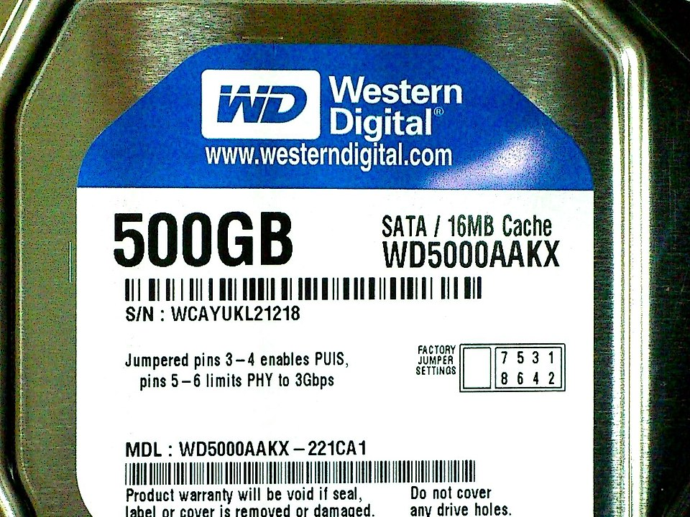
Memory hierarchy example
By Solomon203 - File:WD5000AAKX-221CA1_2012-07-07_2.jpg, CC BY-SA 3.0, https://commons.wikimedia.org/w/index.php?curid=30484513

